Slide 1



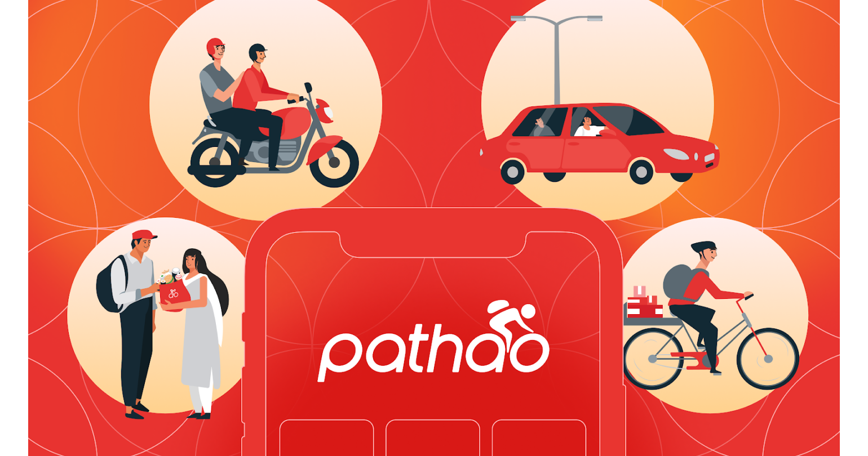

Bikroy.com is not liable for poor or delayed performance, losses, damages, or delays brought on by unavailable or delayed products.sellers handled poorly.
The company declines to take ownership of the subpar service. So that the final consumer may have confidence in the services, at the absolute least, a rating system should be in place.
Daraz: “We reserve the right to refuse access to the Site, terminate accounts, remove or edit content at any time without prior notice to you.”
Informing people when data about them is being gathered does not comply with the data collection policy. Additionally, they will invalidate the username and/or password without providing a justification or prior notice without providing any message or warning.
Your usage of the Site and any personal information you supply to us will be treated in strict confidence in accordance with the Privacy Agreement and any relevant laws and regulations.Even while they meet the requirement for offering more robust security for sensitive data, privacy policies still fall short. The keeping data only as long as necessary principle of data collecting is clearly broken by the fact that they do not disclose to the user how long they store and utilize their data.
Despite the fact that we make every effort to preserve your privacy, we cannot guarantee that your personal information or private chats will always stay secret. They make no promises about protecting your privacy. This conflicts with the idea of gathering data. The business or organization must take full responsibility for guaranteeing the security of the data it has received and will be held accountable if the security is compromised.
Pathao: “The Company may, at its sole and absolute discretion, blacklist users permanently or temporarily and reject the request to use the Application and / or Service or any part there of for such reasons as it deems fit, including but not limited to receiving complaints about you from third party providers or employees of the Company about your behavior or interaction with anyone whatsoever (including but not limited to third party provider, Company’s employees, law enforcement, government authorities) whilst and/or before using the Service.”
This clearly demonstrates that their terms and conditions are opaque. By using the phrase "as it sees fit," they have already introduced several loopholes and claim that there has been no thorough examination into the behaviors that may result in blacklisting.
“Neither we nor any third parties provide any warranty or guarantee as to the security and safety measures related to the storage of your personal information.”
Bkash claims that they can gather information to help identify the data object, such as preferences andInterests. This will be data-violating.collecting guiding principleunneeded information The preferred optioncan't be used to locate the data object.Bkash is unablepossess the necessary confidence to provide personal data with security.

